Slide 1
Predicting BITCOIN values using the BitVaRY™ method
Team Members:
Vasu Chaudhary Rishabh Mulani Yogeshwar Kansara

Slide 2
Agenda
What inspired us?
Project update: What we’ve achieved
Fundamental Concept: GBM (Geometric Brownian Motion)
Difficulties, surprises and shocks along the road
Visualizing the results
Future possibilities
References

Slide 3

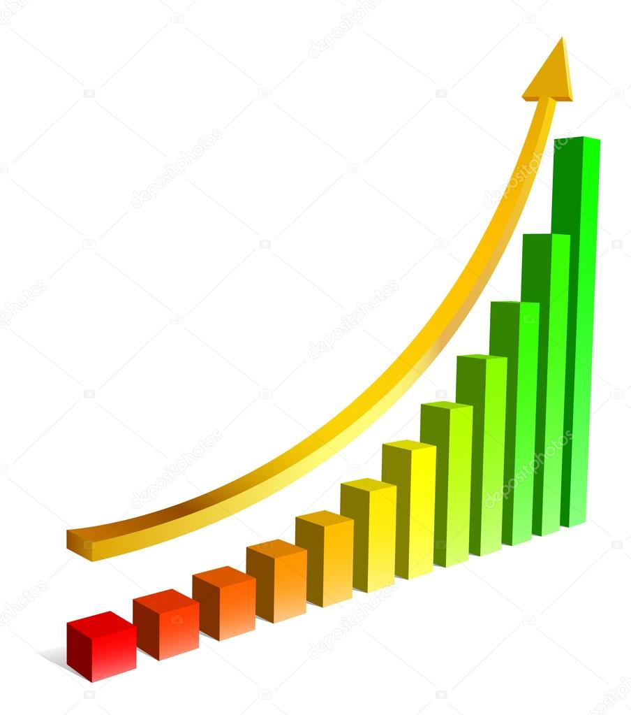
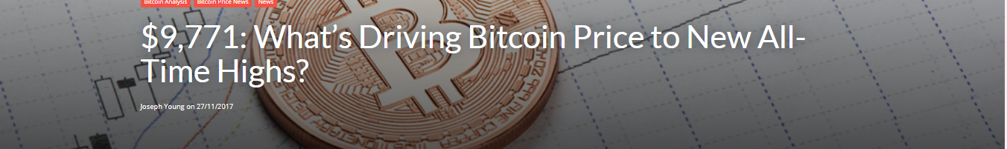

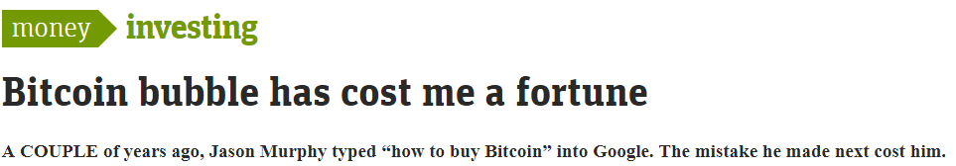


What inspired us?
The recent price surge in the BITCOIN:
BITCOINs have been deemed as the “BEST INVESTMENTS”
The desire to gauge the movement of the bitcoin
So that this doesn’t happen with any of us:
M
BREAKING NEWS!!!! NOV 28, 2017 BITCOIN PRICE SURGES, HITS RECORD HIGH $10,000!

Slide 4
Project update: What we’ve achieved
Successfully extracted required data using a Yahoo! Ticker (The user can choose whether he would like to extract values in USD, EUR or INR)
Calculated volatility, returns, drift and mean drift
Calculated log returns using which we extracted the price data series- This step was performed for a period of 252 days
Monte Carlo Simulation: Simulated this activity 1000 times and plotted that on a matplotlib chart to visualize the simulations
Using the simulation we will predict a most likely range of values for the BITCOIN over the period of the next working year

Slide 5
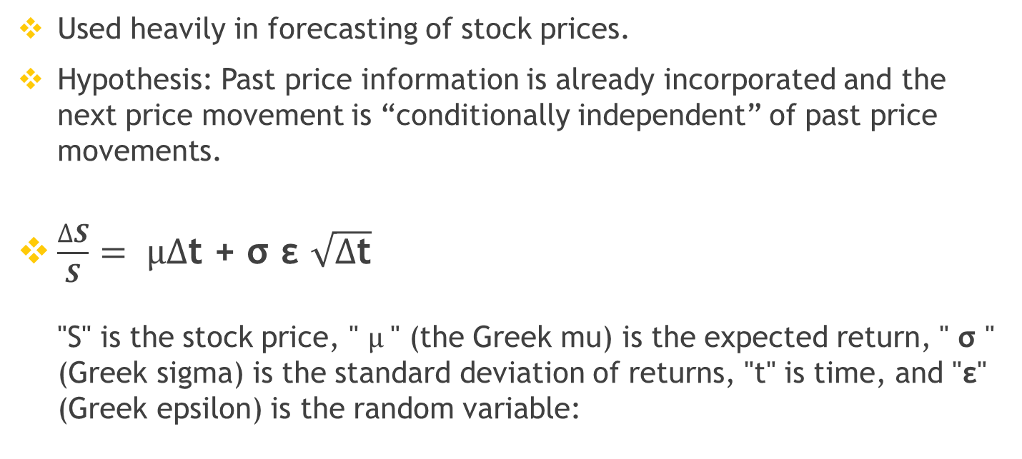
Fundamental Concept: GBM (Geometric Brownian Motion)
Used heavily in forecasting of stock prices.
Hypothesis: Past price information is already incorporated and the next price movement is “conditionally independent” of past price movements.
$\frac{∆S}{S}= µ∆$t + σ ε $\sqrt{∆\text{t}}$ "S" is the stock price, " $µ$" (the Greek mu) is the expected return, " σ " (Greek sigma) is the standard deviation of returns, "t" is time, and "ε" (Greek epsilon) is the random variable:

Slide 6

Difficulties & surprises along the road
Drift & Shock values
FUN FACT!
The Federal Bureau of Investigation controls as much as $120 million Bitcoins making it one of the world’s wealthiest Bitcoin owners
Finding the shock & the drift values of the BitCoin
Variables
The BITCOIN price is determined by many variables and not just the opening and closing price
It was difficult to narrow down on which variables to use
Predicta-bility
The difficulty in predicting the BITCOIN values is increased by 10.44% over the last three years
Project Domain
Understanding different financial, cryptocurrency and stock-market terminologies (Daily volatility, drift, shock, log returns etc.)
6

Slide 7
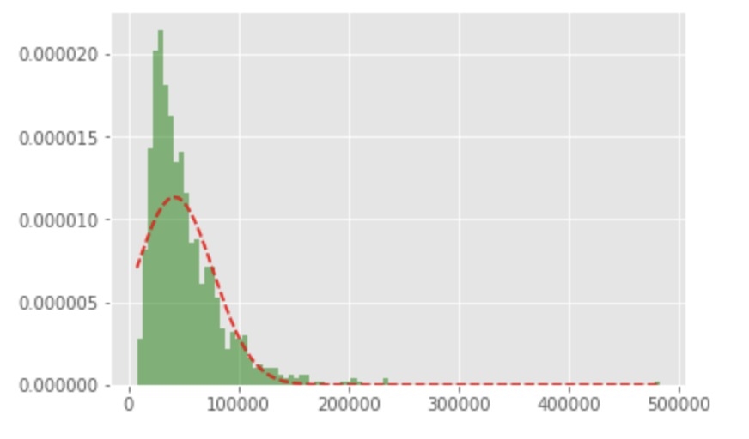
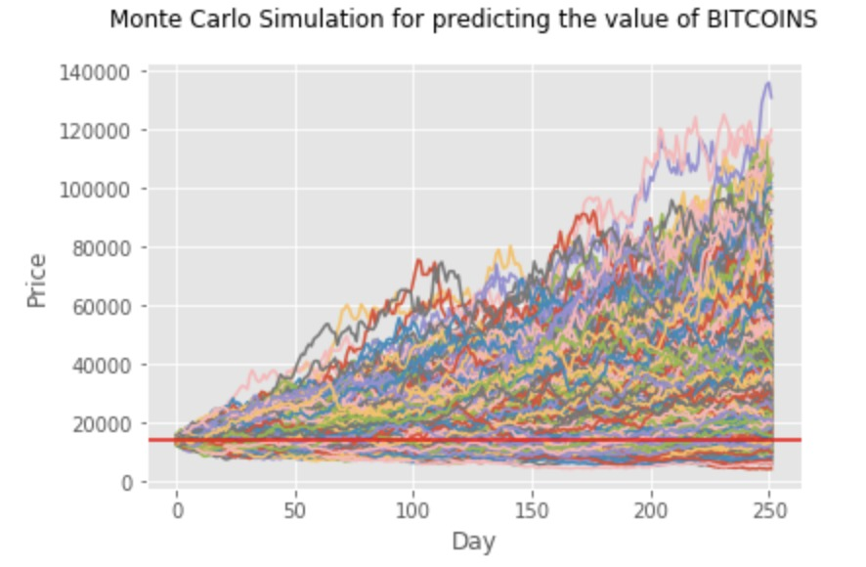
Visualizing the results
Probability of occurrence of a certain price
1000 simulations depicting value ranges

Slide 8

Future possibilities…
Using Text Mining & Natural Language Processing to extract information from news and any other sources
Assign quantitative values to qualitative results from news articles and add/subtract these to/from forecasted values
Increasing the prediction accuracy: Currently our model predicts values based only on quantitative data available, with NLP & TM techniques we can increase our prediction accuracy multifold

Slide 9
References
For historical data: https://www.kaggle.com/mczielinski/bitcoin-historical-data
For problem idea and description & learning about Geometric Brownian Motion: https://www.investopedia.com/articles/07/montecarlo.asp
Quora.com for articles on predicting stocks & bitcoin values: https://www.quora.com/What-are-some-predictions-for-the-price-of-Bitcoin-or-Litecoin-by-2019
Python docs for viewing code examples: https://docs.python.org/3/
A data driven approach to cryptocurrency: https://blog.patricktriest.com/analyzing-cryptocurrencies-python/
Valuewalk.com articles: http://www.valuewalk.com/2017/09/interesting-facts-bitcoin/
The nextweb.com articles: https://thenextweb.com/hardfork/2017/11/28/bitcoin-price-10000-barrier/
Yahoo! Ticker for pulling BTC-USD values

Slide 10

Thank you!

